Slide 1
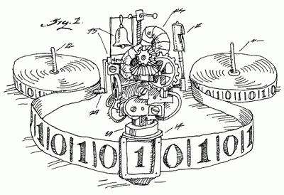
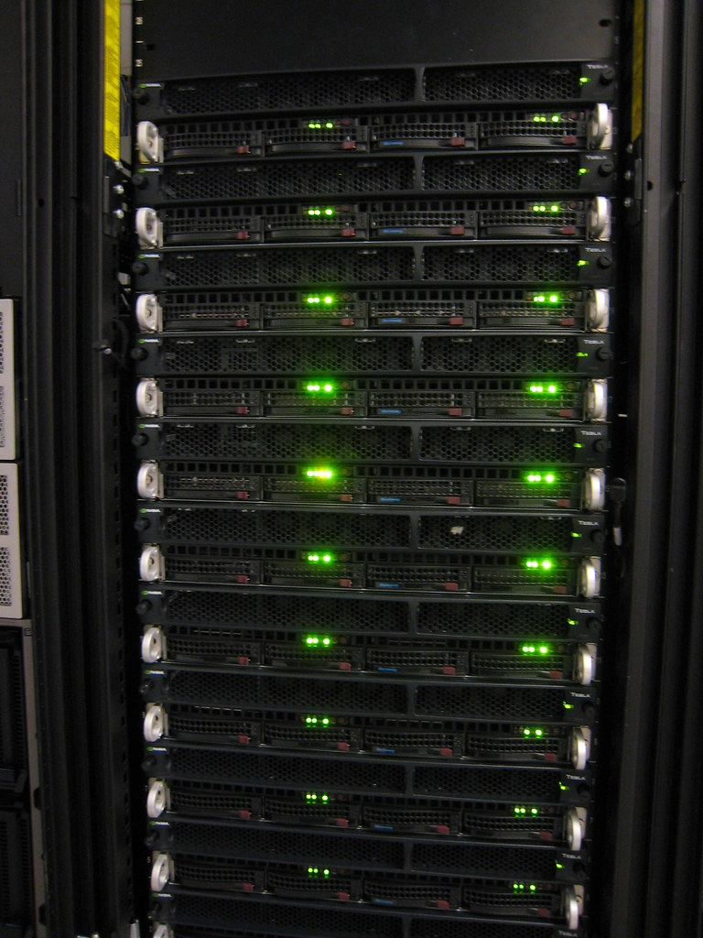
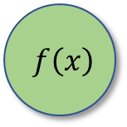
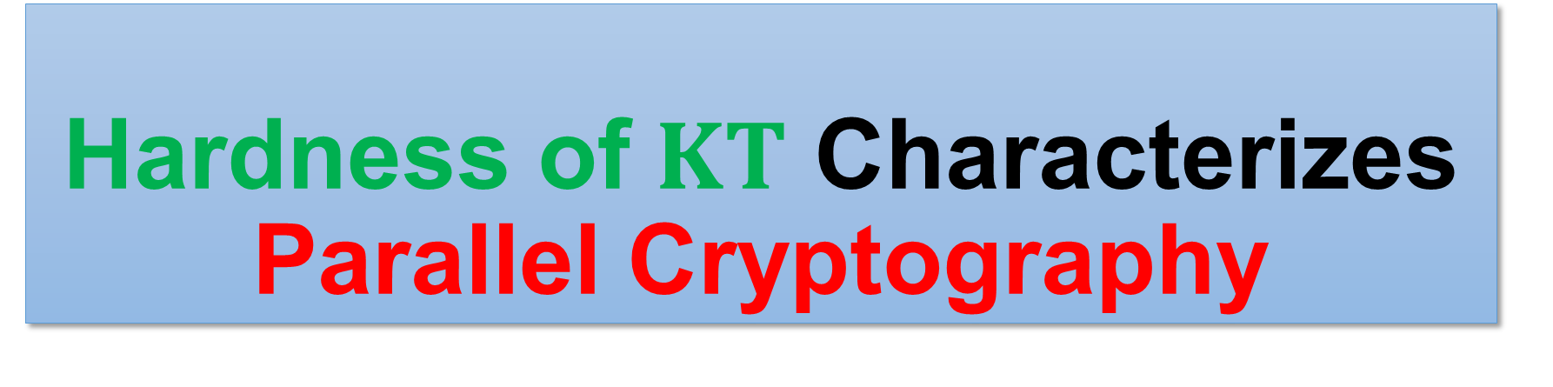
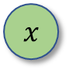

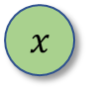
Hardness of $KT$ Characterizes Parallel Cryptography
Hanlin Ren, IIIS, Tsinghua University
Joint work with Rahul Santhanam (Oxford)
Apr 22, Oxford-Warwick Complexity Meetings
$$f\left(x\right)$$
$$f\left(x\right)$$
$$x$$
$$x$$
Thank Rahul for helpful comments that improve this presentation! ☺
1 / 23

Slide 2
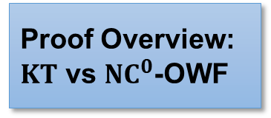
Background: Meta-Complexity
Background: Meta-Complexity
Background: Cryptography
Our Results
Proof Overview: $KT$ vs ${NC}^{0}$-OWF
Conclusions & Discussions
“Complexity of complexity”

Slide 3
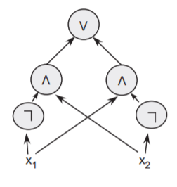

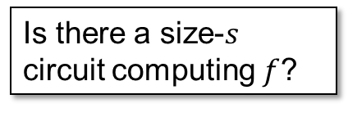
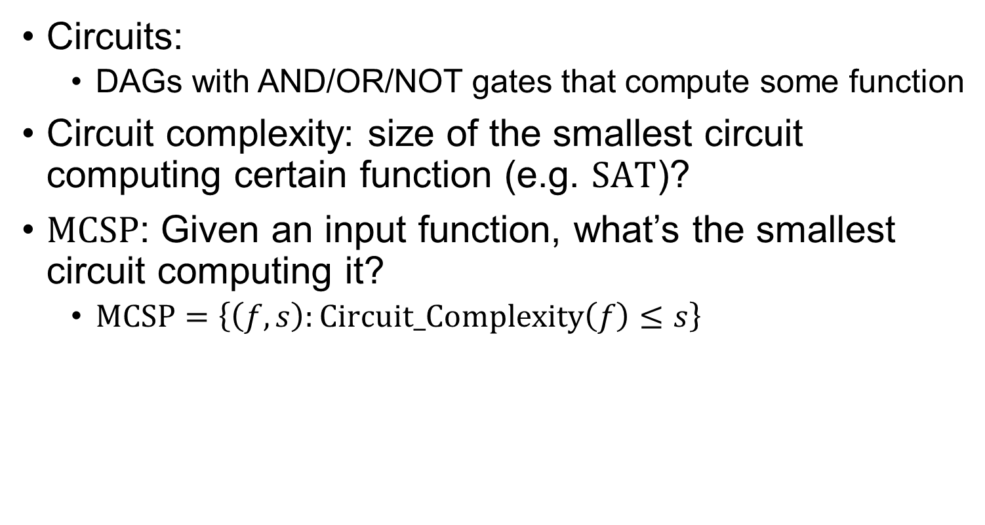
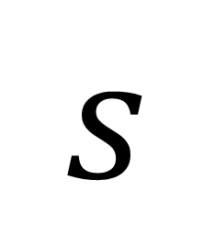
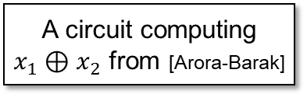
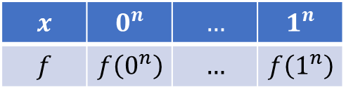
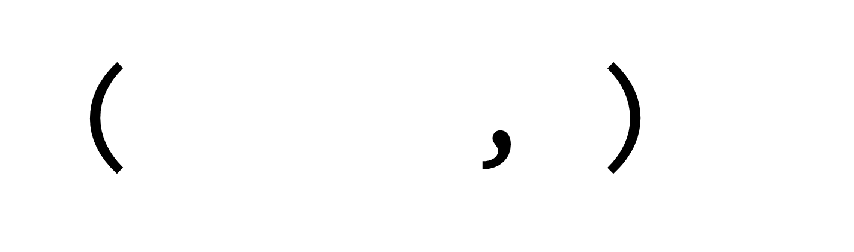
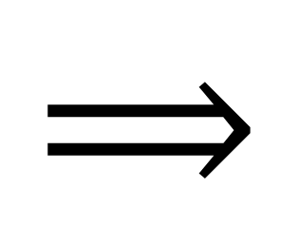
Minimum Circuit Size Problem
Circuits:
DAGs with AND/OR/NOT gates that compute some function
Circuit complexity: size of the smallest circuit computing certain function (e.g. $SAT$)?
$MCSP$: Given an input function, what’s the smallest circuit computing it?
$MCSP=\left\{\left(f, s\right):Circuit_Complexity\left(f\right)≤s\right\}$
A circuit computing $x_{1}⊕x_{2}$ from [Arora-Barak]
( ,$s$)
$$s$$
$$⟹$$
$$x$$ | $$0^{n}$$ | $$…$$ | $$1^{n}$$
$$f$$ | $$f\left(0^{n}\right)$$ | $$…$$ | $$f\left(1^{n}\right)$$
Is there a size-$s$ circuit computing $f$?
2 / 23

Slide 4

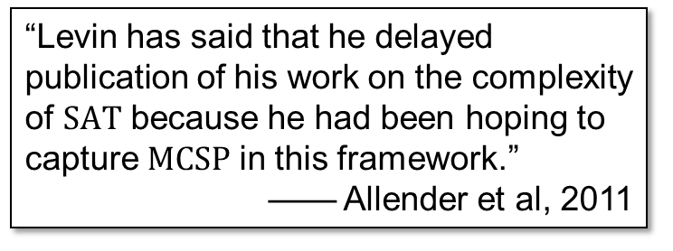
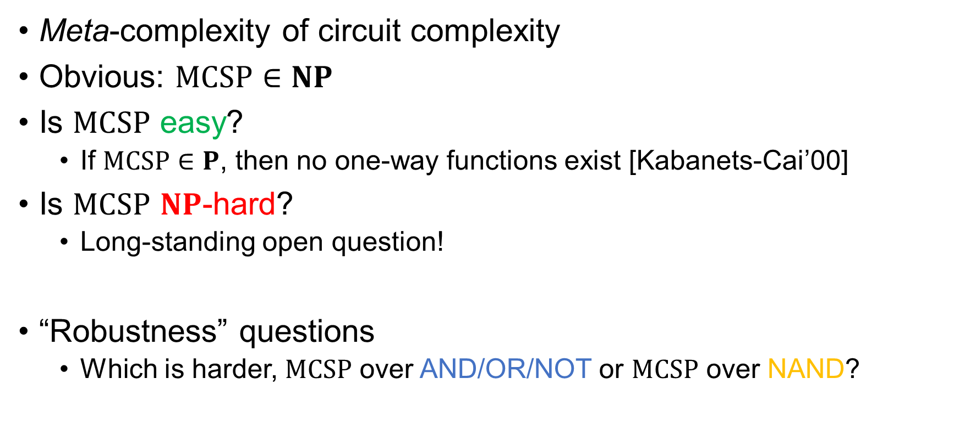
The Complexity of $MCSP$
Meta-complexity of circuit complexity
Obvious: $MCSP∈NP$
Is $MCSP$ easy?
If $MCSP∈P$, then no one-way functions exist [Kabanets-Cai’00]
Is $MCSP$ $NP$-hard?
Long-standing open question!
“Robustness” questions
Which is harder, $MCSP$ over AND/OR/NOT or $MCSP$ over NAND?
“Levin has said that he delayed publication of his work on the complexity of $SAT$ because he had been hoping to capture $MCSP$ in this framework.”
—— Allender et al, 2011
3 / 23

Slide 5
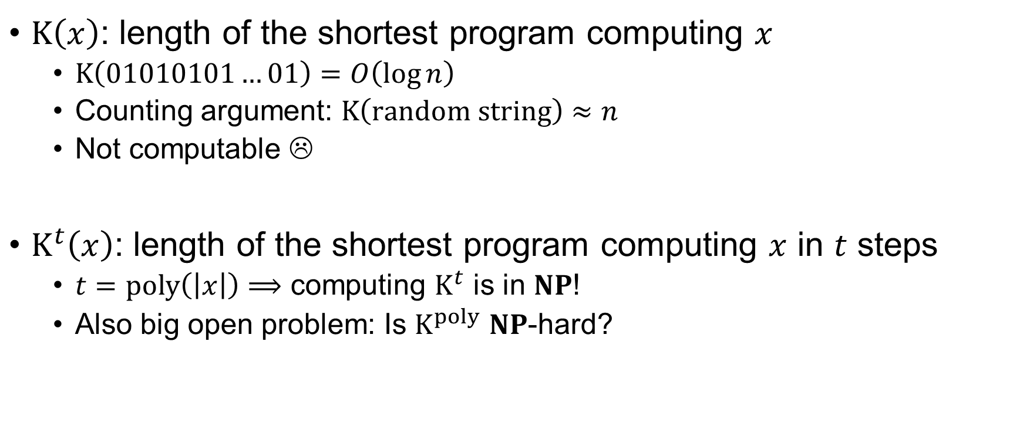
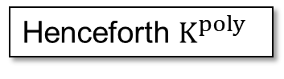
Time-Bounded Kolmogorov Complexity and Its Meta-Complexity
$K\left(x\right)$: length of the shortest program computing $x$
$K\left(01010101…01\right)=O\left(\log{n}\right)$
Counting argument: $K\left(random string\right)≈n$
Not computable ☹
$K^{t}\left(x\right)$: length of the shortest program computing $x$ in $t$ steps
$t=poly\left(\left|x\right|\right)⟹$ computing $K^{t}$ is in $NP$!
Also big open problem: Is $K^{poly}$ $NP$-hard?
print("01" * (n/2))
Henceforth $K^{poly}$
4 / 23
Notes:
On empty input

Slide 6

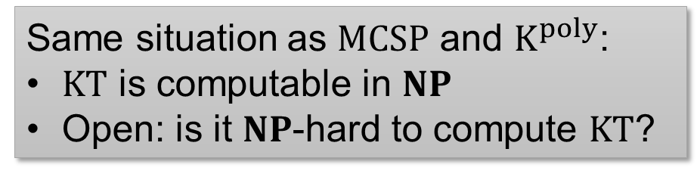
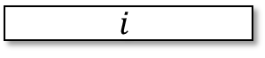
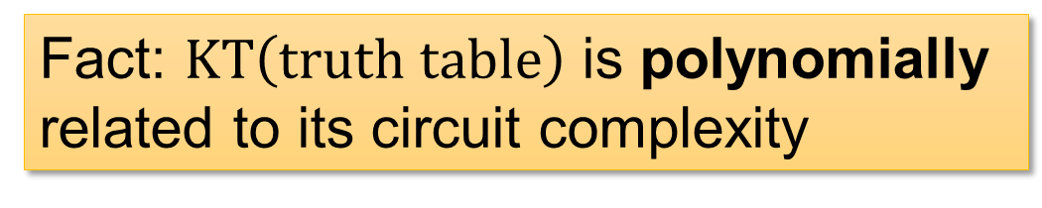
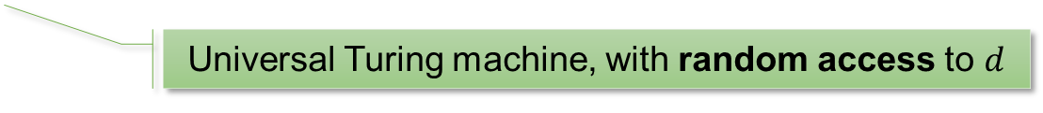
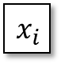
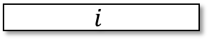
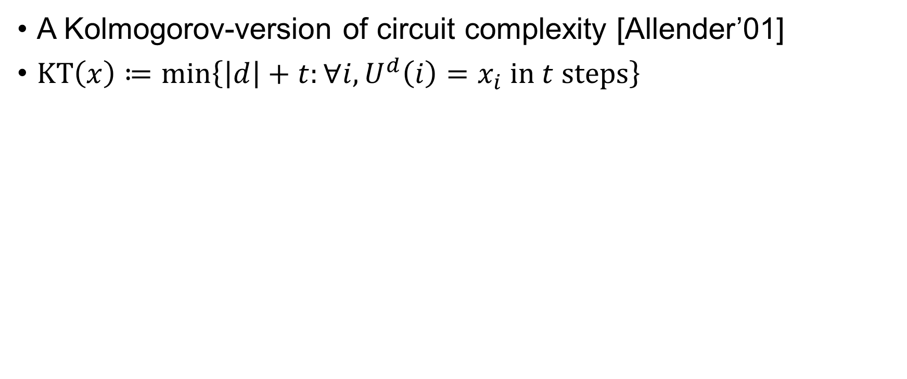
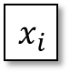

$KT$ Complexity
A Kolmogorov-version of circuit complexity [Allender’01]
$KT\left(x\right)≔\min\left\{\left|d\right|+t:∀i,U^{d}\left(i\right)=x_{i} in t steps\right\}$
Universal Turing machine, with random access to $d$
Fact: $KT\left(truth table\right)$ is polynomially related to its circuit complexity
$$x_{i}$$
$$x_{i}$$
… but $KT$ is sometimes more convenient to deal with.
circuit
$$≈$$
Same situation as $MCSP$ and $K^{poly}$:
$KT$ is computable in $NP$
Open: is it $NP$-hard to compute $KT$?
$$i$$
$$i$$
5 / 23

Slide 7
Background: Cryptography
Background: Meta-Complexity
Background: Cryptography
Our Results
Proof Overview: $KT$ vs ${NC}^{0}$-OWF
Conclusions & Discussions

Slide 8
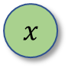
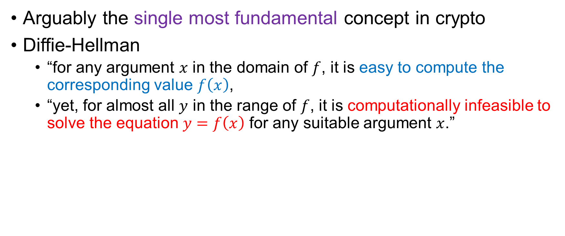
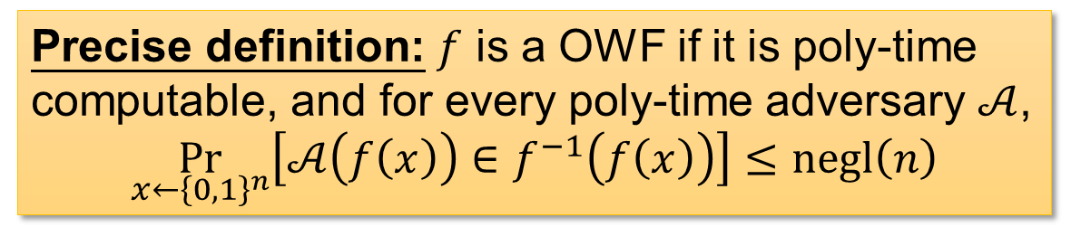

One-Way Functions
Arguably the single most fundamental concept in crypto
Diffie-Hellman
“for any argument $x$ in the domain of $f$, it is easy to compute the corresponding value $f\left(x\right)$,
“yet, for almost all $y$ in the range of $f$, it is computationally infeasible to solve the equation $y=f\left(x\right)$ for any suitable argument $x$.”
easy
A factoring-based candidate
1 def f(x):
2 use x as random bits to sample two primes p, q
3 return p*q
$$f\left(x\right)$$
$$x$$
hard
Precise definition: $f$ is a OWF if it is poly-time computable, and for every poly-time adversary $𝒜$,
$$\underset{x←{\left\{0,1\right\}}^{n}}{Pr}\left[𝒜\left(f\left(x\right)\right)∈f^{−1}\left(f\left(x\right)\right)\right]≤negl\left(n\right)$$
6 / 23
Notes:
The precise def is just to emphasize it’s an average-case definition

Slide 9
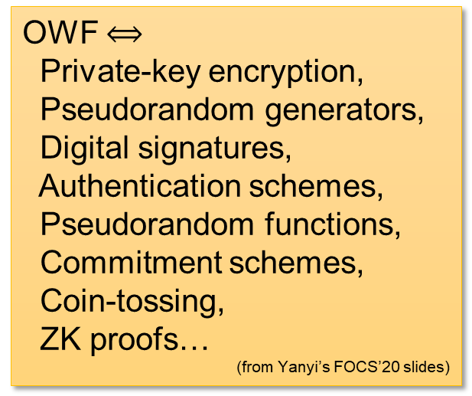

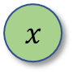
OWFs are Fundamental
Why are OWFs fundamental?
Reason 1: necessary for (almost all) crypto [IL’89]
Reason 2: sufficient for “minicrypt”
OWF $⟺$
Private-key encryption,
Pseudorandom generators,
Digital signatures,
Authentication schemes,
Pseudorandom functions,
Commitment schemes,
Coin-tossing,
ZK proofs…
(from Yanyi’s FOCS’20 slides)
easy
$$f\left(x\right)$$
NOT (known to) include:
Public-key encryption,
Obfuscation
$$x$$
hard
7 / 23

Slide 10
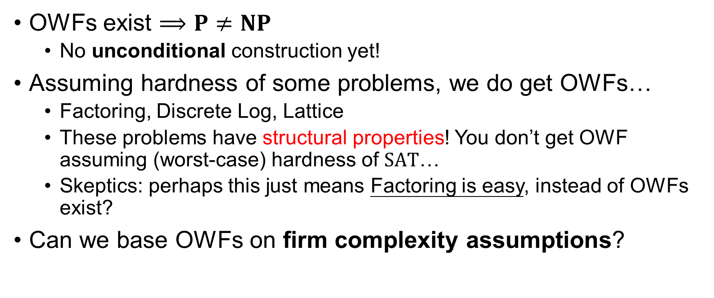
Do OWFs Exist?
OWFs exist $⟹P≠NP$
No unconditional construction yet!
Assuming hardness of some problems, we do get OWFs…
Factoring, Discrete Log, Lattice
These problems have structural properties! You don’t get OWF assuming (worst-case) hardness of $SAT$…
Skeptics: perhaps this just means Factoring is easy, instead of OWFs exist?
Can we base OWFs on firm complexity assumptions?
8 / 23

Slide 11
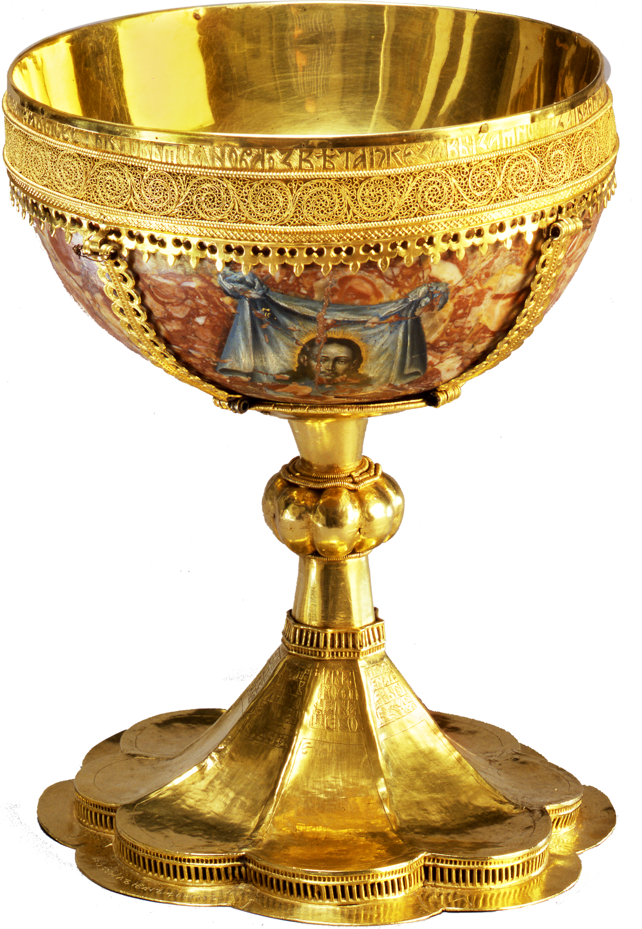
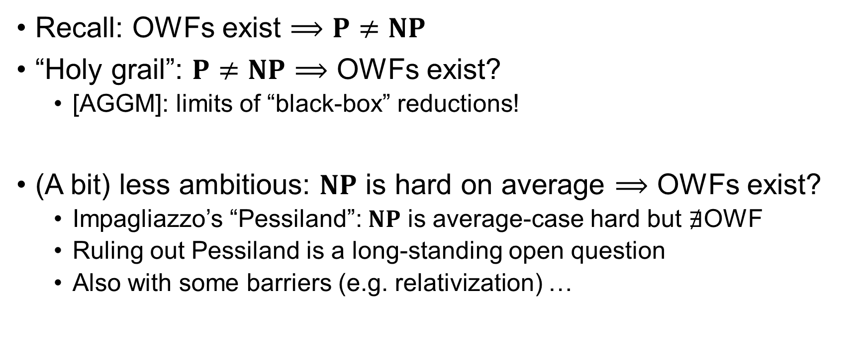
Basing OWFs on “Firm” Complexity Assumptions?
Recall: OWFs exist $⟹P≠NP$
“Holy grail”: $P≠NP⟹$ OWFs exist?
[AGGM]: limits of “black-box” reductions!
(A bit) less ambitious: $NP$ is hard on average $⟹$ OWFs exist?
Impagliazzo’s “Pessiland”: $NP$ is average-case hard but $∄$OWF
Ruling out Pessiland is a long-standing open question
Also with some barriers (e.g. relativization) …
Picture from https://www.pngix.com/transpng/iJohTob/
9 / 23

Slide 12

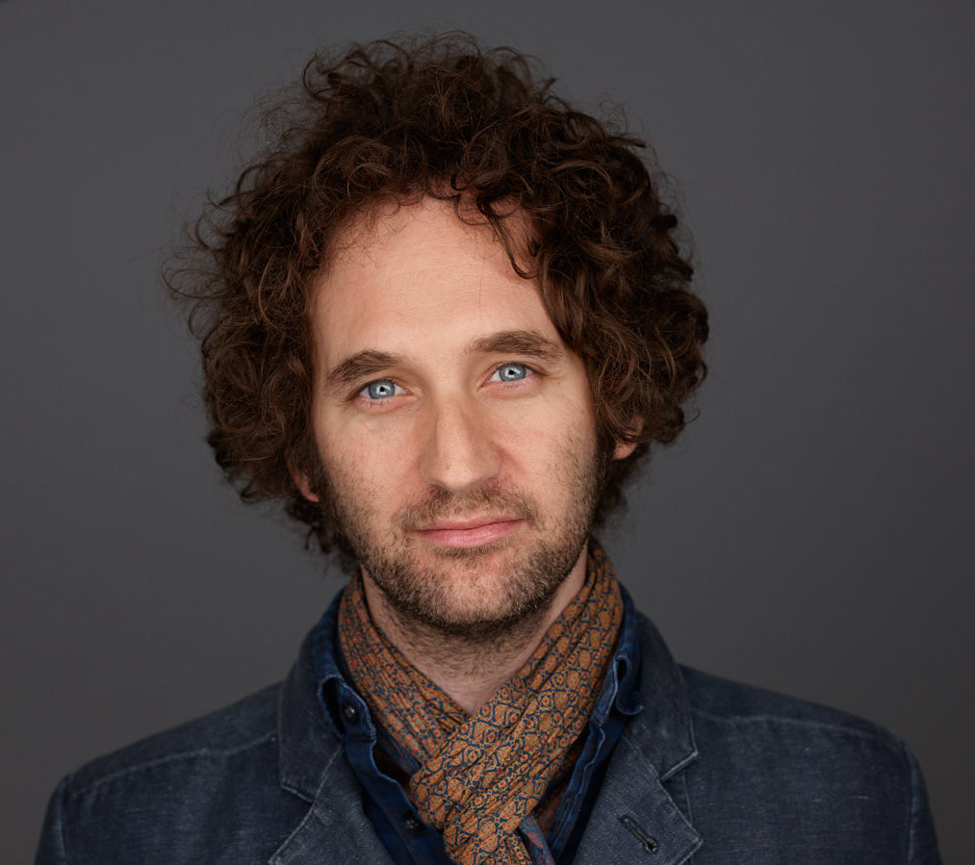
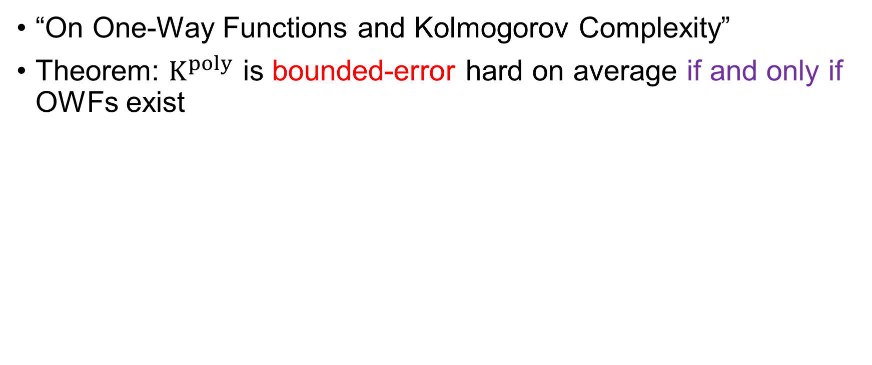
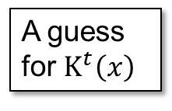
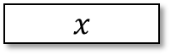
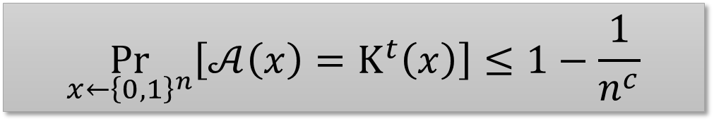
The Liu-Pass Result
“On One-Way Functions and Kolmogorov Complexity”
Theorem: $K^{poly}$ is bounded-error hard on average if and only if OWFs exist
Characterizing the central crypto primitive (OWF) by the complexity of a natural problem over the uniform distribution!
Poly-time heuristic
A guess for $K^{t}\left(x\right)$
$$x$$
Exists an absolute constant $c$, for every poly-time heuristic $𝒜$,
$$\underset{x←{\left\{0,1\right\}}^{n}}{Pr}\left[𝒜\left(x\right)=K^{t}\left(x\right)\right]≤1−\frac{1}{n^{c}}$$
Base crypto on firm complexity assumptions!
(How could you do better than a characterization?)
10 / 23
Notes:
K^poly is an independently interesting notion!

Slide 13
Our Results
Background: Meta-Complexity
Background: Cryptography
Our Results
Proof Overview: $KT$ vs ${NC}^{0}$-OWF
Conclusions & Discussions

Slide 14
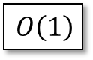
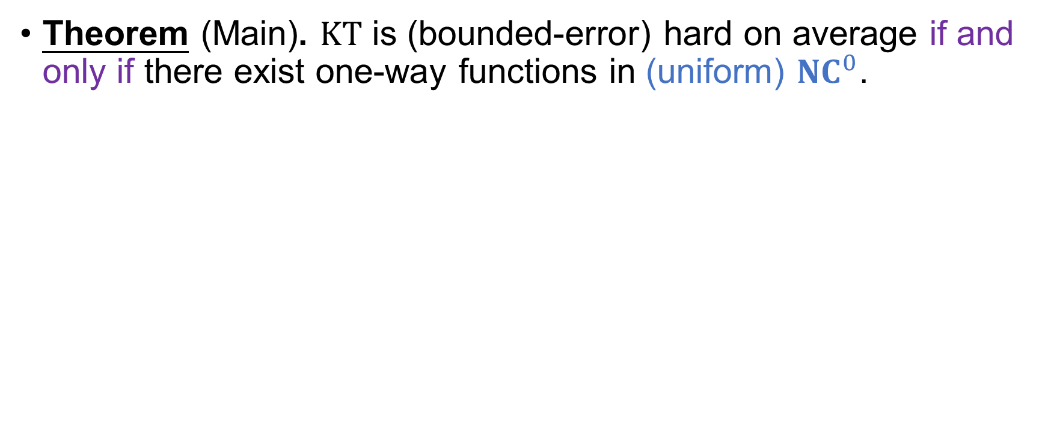
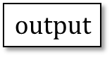
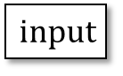
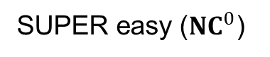
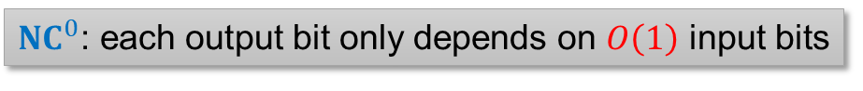

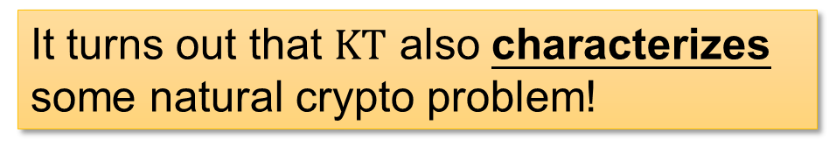

Our Result 1
Theorem (Main). $KT$ is (bounded-error) hard on average if and only if there exist one-way functions in (uniform) ${NC}^{0}$.
It turns out that $KT$ also characterizes some natural crypto problem!
SUPER easy (${NC}^{0}$)
$$output$$
$$f\left(x\right)$$
$$O\left(1\right)$$
$$x$$
$$input$$
hard
${NC}^{0}$: each output bit only depends on $O\left(1\right)$ input bits
11 / 23

Slide 15
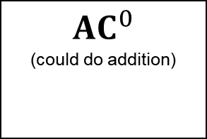
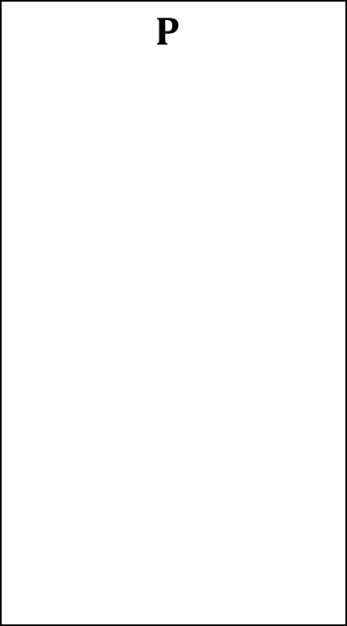


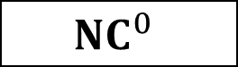











Cryptography in ${NC}^{0}$
[Applebaum-Ishai-Kushilevitz, FOCS’04]
OWF computable in ${NC}^{1}$ or even $LOGSPACE$ implies OWF computable in ${NC}^{0}$
${NC}^{0}$-OWF follows from most standard crypto assumptions!
$$P$$
$$⋯$$
$${NC}^{2}$$
$$LOGSPACE$$
$${NC}^{1}$$
$${TC}^{0}$$
(contains most arithmetic operations)
$$LOGSPACE$$
$${NC}^{0}$$
$$f\left(x\right)$$
“AIK compiler”
$$f^{∗}\left(x\right)$$
$${AC}^{0}$$
(could do addition)
$$x$$
$$x$$
hard
ALSO hard
$${NC}^{0}$$
12 / 23

Slide 16













Wrap Up
$$KT\left(x\right)≔\min\left\{\left|d\right|+t:∀i,U^{d}\left(i\right)=x_{i} in t steps\right\}$$
${NC}^{0}$: a super easy class
$$x_{i}$$
$$output$$
$$O\left(1\right)$$
Polynomially related to circuit complexity…
$$input$$
${NC}^{0}$: each output bit only depends on $O\left(1\right)$ input bits
$$i$$
OWF in ${NC}^{0}$:
Widely believed to exist!
Still, somewhat stronger than plain OWF
Our result 1: $KT$ is (bounded-error) hard on average if and only if there exist one-way functions in (uniform) ${NC}^{0}$.
SUPER easy (${NC}^{0}$)
$$f\left(x\right)$$
$$x$$
hard
13 / 23

Slide 17









Our Result 2: AIK as a Reduction
[Liu-Pass]: (hardness of $K^{poly}$) $=$ (OWF)
[Liu-Pass]: (hardness of $ℭ$-$K^{poly}$) $=$ (OWF computable in $ℭ$)!!
[AIK]: (OWF computable in ${NC}^{1}$) $=$ (OWF computable in ${NC}^{0}$)!
(for “reasonable” $ℭ$)
[Liu-Pass]
[AIK]
[Liu-Pass] + [AIK]: (hardness of ${NC}^{1}$-$K^{poly}$) = (hardness of ${NC}^{0}$-$K^{poly}$) !!!
For now, think of ${NC}^{0}$-$K^{poly}≈KT$
${NC}^{1}$-$K^{poly}$ and $KT$ are equally hard (on average). Is there a reduction between them?
14 / 23
Notes:
Crypto techniques (?) to understand meta-complexity

Slide 18




Our Result 2: AIK as a Reduction
Theorem (Informal). There is a randomized reduction that
maps a random instance to a random instance, and
maps an instance with small ${NC}^{1}$-$K^{poly}$ to an instance with small $KT$
Remark 1
The same idea also works for $LOGSPACE$-$K^{poly}$.
Remark 2
If AIK could prove “OWF (in $P$) implies OWF in ${NC}^{0}$”, then we could reduce $K^{poly}$ to $KT$
Previously, it’s unknown if $K^{poly}$ and $KT$ has ANY connection at all!!!
Corollary
If $KT$ is zero-error easy on average, then so are ${NC}^{1}$-$K^{poly}$ and $LOGSPACE$-$K^{poly}$.
Lesson: By opening the magical black-box of AIK, we also obtain nontrivial consequences on zero-error average-case complexity of meta-complexity!
15 / 23

Slide 19





Our Result 3: Towards the Hardest OWF?
[Liu-Pass] provides an opportunity to study the most secure OWF!
Strong OWF: adversary inverts w.p. $negl\left(n\right)$
Weak OWF: adversary inverts w.p. $≤1−1/n^{c}$ for fixed $c$
Theorem (Informal): For any “typical” function $S\left(n\right)$, there is a weak OWF with security $S\left(n\right)⋅n^{Θ\left(\log{n}\right)}$ if and only if $K^{poly}$ is average-case hard for $S\left(n\right)⋅n^{Θ\left(\log{n}\right)}$-size algorithms
The $n^{Θ\left(\log{n}\right)}$ factor comes from state-of-the-art extractors [GUV] with seed length $O\left(\log^{2}{n}\right)$…
Conclusion: average-case complexity of $K^{poly}$ characterizes the hardest weak OWF
16 / 23

Slide 20



One Slide for $MCSP$…
Circuit complexity is messier to deal with…
Theorem. If $MCSP$ is exponentially hard on average, then there is a (super-poly) hard OWF.
Theorem. If there is an exponentially-hard (weak) OWF in ${NC}^{0}$, then $MCSP$ is (exponentially) hard on average.
Open: implement this OWF in ${NC}^{0}$!
If $KT$ is (super-poly) hard on average, then there is a (super-poly) OWF in ${NC}^{0}$
If there is a (super-poly) OWF in ${NC}^{0}$, then $KT$ is (super-poly) hard on average
17 / 23

Slide 21



Proof Overview: $KT$ vs ${NC}^{0}$-OWF
Background: Meta-Complexity
Background: Cryptography
Our Results
Proof Overview: $KT$ vs ${NC}^{0}$-OWF
Conclusions & Discussions
Theorem (Main). $KT$ is (bounded-error) hard on average if and only if there exist one-way functions in (uniform) ${NC}^{0}$.

Slide 22








Warm-Up: OWF $⟹$ (Worst-Case) Hardness of $K^{poly}$
Small $K^{t}$
Large $K^{t}$
PRG
${\left\{0,1\right\}}^{n}$
$$seed$$
PRG
$$output$$
$$K^{t}\left(output\right)≤\left|seed\right|+O\left(1\right)$$
(Worst-case) algo for $K^{poly}⟹$ distinguisher for ANY PRG!
18 / 23

Slide 23



We Only Have a Heuristic…?
PRG
Heuristic for $K^{poly}$
${\left\{0,1\right\}}^{n}$
“dense” PRG
$$seed$$
PRG
$$output$$
$$K^{t}\left(output\right)≤\left|seed\right|+O\left(1\right)$$
[Liu-Pass]:
OWF $⟹$ “dense” PRG
PRG has to be dense $⟹$ seed length $≥n−O\left(\log{n}\right)$
Note: In [Liu-Pass], “dense” PRG is actually called “condEP-PRG”.
19 / 23

Slide 24







What PRGs Imply Hardness of $KT$?
Goal: design a dense PRG that can be broken by a heuristic for $KT$.
Instead of $K^{poly}$!
“dense” PRG
$$\left|seed\right|≥n−O\left(\log{n}\right)$$
$$\left|output\right|=n$$
$$KT\left(output\right)≤\left|seed\right|+PRG_Time$$
Crypto in ${NC}^{0}$!!!
$$⟹PRG_Time≤O\left(log n\right)$$
20 / 23

Slide 25








Parallel OWF $⟹$ Hardness of $KT$
$$seed$$
“dense” PRG in ${NC}^{1}$
“dense” PRG
“dense” PRG in ${NC}^{0}$
OWF in ${NC}^{1}$
OWF
AIK compiler
Other ingredients from [Liu-Pass] (e.g. extractors)
$$output$$
Heuristic for $KT⟹$ no OWF in ${NC}^{0}$!
$$KT\left(output\right)≤\left|seed\right|+O\left(\log{n}\right)$$
21 / 23

Slide 26


Hardness of $KT⟹$ Parallel OWF
Borrowed from [Liu-Pass]: $f\left(d,t\right)=\left(\left|d\right|+t, output\left(d,t\right)\right)$
Adversary sees $\left(s,x\right)$, needs to find a witness of “$KT\left(x\right)≤s$”.
If $KT$ is hard then $f$ is a (weak) OWF
Is $f$ computable in ${NC}^{0}$? ☹
Observation: for most strings $x$, if $KT\left(x\right)=\left|d\right|+t$, then $t$ is small
In particular, this is true if $x$ has large Kolmogorov complexity
$f$ restricted to $t≤O\left(\log{n}\right)$ is still a OWF
$f$ computable in $LOGSPACE$, can apply [AIK]
22 / 23

Slide 27
Conclusions & Discussions
Background: Meta-Complexity
Background: Cryptography
Our Results
Proof Overview: $KT$ vs ${NC}^{0}$-OWF
Conclusions & Discussions

Slide 28

Discussion: A Karp Theorem for OWF?
Liu-Pass: “Cook-Levin theorem for OWF”?
$K^{poly}$ is “OWF-complete”!
Speculation: Is there a Karp theorem for OWF?
Could (some version of) random 3SAT / subset sum / planted clique be also “OWF-complete”?
More generally, any combinatorial problem that is OWF-complete?
The OWF from random 3SAT is actually in ${NC}^{1}$, so maybe we should focus on a Karp theorem for “OWF in ${NC}^{0}$”?
Story: Rahul asked this question in Rafael Pass’s Oxford-Warwick meeting. It seemed unlikely to me (!) but I didn’t find any evidence against such a Karp theorem anyway. So we worked on it (positively!) and somehow arrived at the current paper ☺
Combinatorial OWF-complete problems may be an avenue for bypassing the relativization barrier…
23 / 23

Slide 29
Thank you!
Questions are welcome! ☺

Slide 30



Proof Overview: Reducing $K^{poly}$ to $KT$?
Proof Overview: Reducing $K^{poly}$ to $KT$?
Theorem (Informal). There is a randomized reduction that
maps a random instance to a random instance, and
maps an instance with small ${NC}^{1}$-$K^{poly}$ to an instance with small $KT$

Slide 31

































Key Technique: Resamplability
A function $f$ is resamplable if given $x$ and random bits, we can compute a random $y∈f^{−1}\left(f\left(x\right)\right)$ in ${NC}^{0}$
Assumption
There is a language $L$ that is resamplable and $P$-complete (under projections)
$$y_{1}$$
$$y_{2}$$
$$y_{3}$$
$$y_{4}$$
$$y_{5}$$
$$y_{6}$$
$$y_{7}$$
$$y_{8}$$
$$y_{9}$$
$$y_{10}$$
$$x_{1}$$
$$x_{2}$$
$$x_{3}$$
$$x_{4}$$
$$x_{5}$$
$$x_{6}$$
$$x_{7}$$
$$x_{8}$$
$$x_{9}$$
$$x_{10}$$
We will design an average-case reduction from $K^{poly}$ to $KT$ under this assumption.
$$r_{1}$$
$$r_{2}$$
$$r_{3}$$
$$r_{4}$$
$$r_{5}$$
$$r_{6}$$
$$r_{7}$$
$$r_{8}$$
$$r_{9}$$
Example: $PARITY$ is resamplable in ${NC}_{3}^{0}$
There is indeed a resamplable ${NC}^{1}$-hard language, so our result holds unconditionally for ${NC}^{1}$-$K^{poly}$.
1 / 6

Slide 32
















Reducing $K^{poly}$ to $KT$
Input: $x∈{\left\{0, 1\right\}}^{n}$, $1^{t}$. Question: what’s $K^{t}\left(x\right)$?
$Reduction\left(x\right)=y_{1}y_{2}…y_{n}$
$y_{i}$ is a random length-$poly\left(t\right)$ input of $L$ with $L\left(y_{i}\right)=x_{i}$
Easy: (If $L$ is balanced) the reduction maps a random string to a random string
$$x=$$
$$0$$
$$1$$
$$1$$
$$…$$
$$0$$
$$y=$$
Random $0$-input of $L$
Random $1$-input of $L$
Random $1$-input of $L$
$$…$$
Random $0$-input of $L$
Assumption
There is a language $L$ that is resamplable and $P$-complete (under projections)
A function $f$ is resamplable if
given $x$ and random bits, we can compute a random $y∈f^{−1}\left(x\right)$ in ${NC}^{0}$
2 / 6

Slide 33





















Reducing $K^{poly}$ to $KT$
$$x=$$
$$0$$
$$1$$
$$1$$
$$…$$
$$0$$
Does it reduce an easy string to an easy string?
To prove: $K^{t}\left(x\right)≤\left|x\right|−σ⟹KT\left(y\right)≤\left|y\right|−σ+O\left(\log{n}\right)$.
For ALL $y$!
Step I: reduce the computation to $L$
$$y=$$
Random $0$-input of $L$
Random $1$-input of $L$
Random $1$-input of $L$
$$…$$
Random $0$-input of $L$
$$s_{i}∈L⟺x_{i}=1$$
$$s_{1}$$
$$s_{2}$$
Assumption
There is a language $L$ that is resamplable and $P$-complete (under projections)
$$s_{3}$$
$$\left|x\right|−σ$$
$${NC}^{0}$$
$$⋯$$
$$s_{n}$$
$$x$$
$$\left|s_{i}\right|=poly\left(t\right)$$
3 / 6

Slide 34






Reducing $K^{poly}$ to $KT$
$$x=$$
$$0$$
$$1$$
$$1$$
$$…$$
$$0$$
Step II: resample!
$$y=$$
Random $0$-input of $L$
Random $1$-input of $L$
Random $1$-input of $L$
$$…$$
Random $0$-input of $L$
Note: need that the resampling procedure uses an optimal number of random bits.
(which is true for the unconditional ${NC}^{1}$-hard resamplable language as well as $PARITY$.)
$$\left|s_{i}\right|=poly\left(t\right)$$
$$s_{i}$$
$$random$$
$${NC}^{0}$$
Assumption
There is a language $L$ that is resamplable and $P$-complete (under projections)
Random $x_{i}$-input of $L$
4 / 6

Slide 35




















Mapping Low-$K^{poly}$ Instances to Low-$KT$ Instances
Putting it together…
Random $x_{1}$-input of $L$
$$s_{1}$$
$$=KT\left(y\right) \\ ≤\left|x\right|−σ+\left|random\right|+O\left(\log{n}\right) \\ =\left|y\right|−σ+O\left(\log{n}\right)$$
$$s_{2}$$
Random $x_{2}$-input of $L$
$${NC}^{0}$$
$$s_{3}$$
$$\left|x\right|−σ$$
Random $x_{3}$-input of $L$
$$⋯$$
$${NC}^{0}$$
$$y$$
$$s_{n}$$
$$\left|s_{i}\right|=poly\left(t\right)$$
$$⋯$$
$$random bits$$
$$random bits$$
$$random bits$$
Random $x_{n}$-input of $L$
$$random bits$$
5 / 6

Slide 36






Wrap Up
Theorem (Informal): There is a randomized reduction that
maps a random instance to a random instance, and
maps an instance with small $K^{poly}$ to an instance with small $KT$
${NC}^{1}$-$K^{poly}$
$LOGSPACE$-$K^{poly}$
Assumption
There is a language $L$ that is resamplable and $P$-complete (under projections)
Corollary
If $KT$ is zero-error easy on average, then so are ${NC}^{1}$-$K^{poly}$ and $LOGSPACE$-$K^{poly}$.
Assumption
There is a language $L$ that is resamplable and $P$-complete (under projections)
6 / 6

